Slide 1
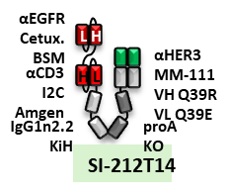
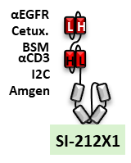
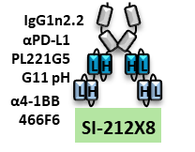
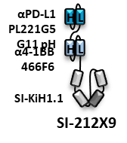
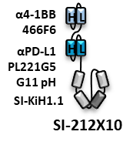
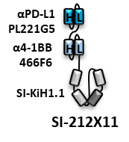
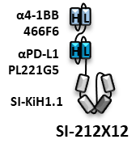
Molecule |  |  | 212T14* | 212X1 | 212X8 | 212X9 | 212X10 | 212X11 | 212X12
Starting material % Monomer |  |  | 87 | 92 | 83 | 94 | 88 | 90 | 92
Time (days) | Monomer% in Plasma | 0 | 71 | 83 | 83 | 72 | 69 | 70 | 70
 |  | 3 | 64 | 80 | 87 | 70 | 76 | 69 | 66
 |  | 7 | 59 | 68 | 86 | 69 | 78 | 67 | 66
 | Monomer% loss D0-D3 |  | -4.1 | -4.9 | 5.9 | -2.7 | -2.2 | -1.4 | -5.7
Control Identified:
Day 0 monomer loss, and stable for 7 days

